Slide 1
Barriers to Access to HIV Diagnosis and Treatment
Ingrid V. Bassett, MD, MPH
Massachusetts General Hospital
Notes:
Thank you very much. It’s a pleasure to be here.

Slide 2
Road Map
Global progress toward first two “90”s
Barriers to progress
Novel testing approaches
Novel linkage solutions
Conclusions and what’s next
Notes:
I am going to be speaking today about global progress toward HIV testing and linkage to care goals – the first two “90”s
Then, I am going to talk about barriers to progress and their impact on HIV testing and linkage
I’ll show some examples of recent novel testing approaches to try to overcome these barriers and then some novel linkage solutions–and finally some conclusions and what’s next for areas that need more work.

Slide 3
Global progress toward 90-90-90, 2018
Linkage to prevention services
TESTING
90% PLWH know their status
ON ART
90% who know their status on ART
VIRAL SUPPRESSION
90% on ART virally suppressed
91%
92%
>95%
79%
78%
86%
BOTSWANA
GLOBAL
89%
87%
95%
AUSTRALIA
UNAIDS, 2019; Kirby Institute 2018
Notes:
The talk today will focus on the UNAIDS targets for HIV testing, having 90% of PLHIV knowing there HIV status (the first 90) and on linking to care and intiating ART (the second 90).
Reaching the targets is achievable in some settings –here is the example of Botswana, from a generalized HIV epidemic and here is Australia, a more concentrated HIV epidemic. While these goals may be achievable, most countries in the world fall well short of the targets.
Globally, it is estimated that 79% of PLWH know their status and 78% of those are on ART. I will not be speaking about the 3rd 90, as Dr. Maimela spoke eloquently about that in yesterday’s plenary. I will be talking about the fact these steps are non linear (press) such that people on ART may leave care and then return again and re-initiate treatment.
Though I am not talking about prevention today, I would also like to mention the importance for people found to have an HIV negatives status to link to HIV prevention services (press).
With 79% of people knowing their status, how do we go about finding the last 21% of people living with HIV who don’t know their status? What are the barriers to finding those people and getting them into care?

Slide 4
Barriers to progress
Notes:
Now I am going to talk about some of those barriers that span both HIV testing and linkage. This includes patient populations that have multiple barriers and require more innovative approaches.

Slide 5
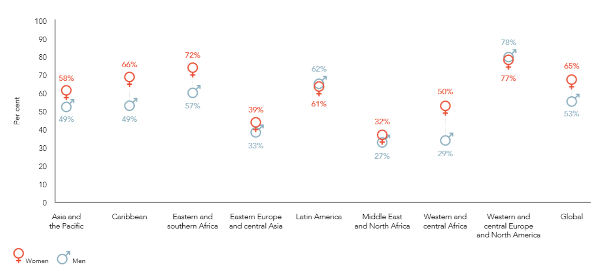
Men are less likely to initiate ART
% ART coverage
Asia and the Pacific
Caribbean
Eastern and southern Africa
Eastern Europe and central Asia
Latin America
Middle East and north Africa
Western and central Africa
Western and central Europe and North America
Barriers: social norms about masculinity, opportunity costs of missing work, anticipated stigma, loss of social standing
UNAIDS, 2018
Notes:
The first patient population that I want to highlight is Men. Men are less likely than women to test and initiate and adhere to ART. In almost all regions of the world, women (shown in red) are more likely to be on ART as compared to men (shown in blue). This is true in generalized epidemics such as in E and Southern Africa and in more concentrated epidemics such as in E Europe and central Asia. And this translates into increased mortality for men worldwide. Men experience a number of barriers – including social norms about masculinity, opportunity costs for missing work, and anticipated stigma and loss of social standing if diagnosed with HIV.

Slide 6
Adolescents least likely to know status, USA
Barriers: lack of perceived risk, worries about rejection, never offered a test, inconvenient hours/clinics, parental consent laws
CDC, 2018
Notes:
Another group with barriers is adolescents. Here are proportion of people diagnosed, receiving care and in retained in care, by age groups in the US. Here in purple we see that adolescents age 13-24 are lowest of all age groups This is the experience with adolescence globally. Some of the most common psychological barriers to HIV testing among adolescents are lack of perceived risk and worries about rejection. There are also structural barriers to HIV testing and linkage including never being offered an HIV test, inconvenient clinic hours and structure, and parental consent laws. The majority of countries have parental consent laws for people under the age of 18 for accessing services that include HIV testing and treatment. These laws may be especially detrimental for young MSM of color in the US and young women in sSA who each bear a disproportionate burden of new HIV infections.

Slide 7
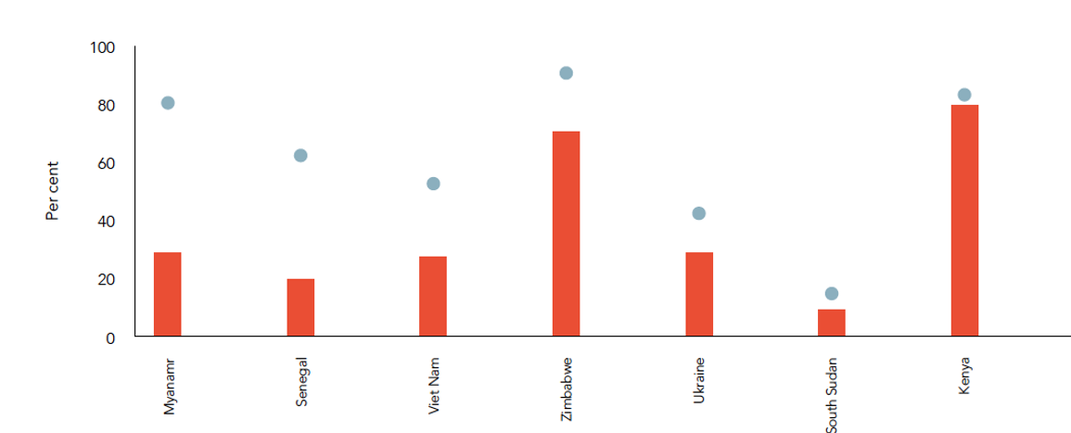
Treatment access lags behind in key populations – Female Sex Workers
Women ≥ 15 y/o
% ART coverage
FSW
Myanmar
Senegal
Viet Nam
Zimbabwe
Ukraine
South Sudan
Kenya
Barriers: difficulty reaching clinics, out of pocket costs, lack of confidentiality, stigma, criminalization of work
UNAIDS, 2018
Notes:
Turning to key populations, we know that KPs are at higher risk for HIV and that more than half of new HIV infections globally in 2018 were among key populations and their sexual partners. Though they are at higher risk, their access to treatment tends to lag behind the general population.
Here is an example, showing different countries throughout the world, with the % of people accessing ART, the blue dots representing treatment coverage in general adult population and the red bars representing treatment coverage for FSW. Almost uniformly, FSW are less likely than the general population to be accessing ART. This is often true for other key populations as well, including men who have sex with men, trans women, and people who inject drugs.

Slide 8
Discrimination within healthcare setting is a formidable barrier
Percentage of people living with HIV who experienced discrimination in health-care settings, 2012-2017
Algeria
Morocco
Mauritius
Tajikistan
Ukraine
Kazakhstan
Germany
Paraguay
Zimbabwe
0 10 20 30 40 50 60 70 80 90 100
Health-care professional ever told other people about their HIV status without their consent
Denied health services because of their HIV status at least once in the past 12 months
UNAIDS, 2018
Notes:
A major barrier for people seeking care is unfortunately stigma and discrimination in the healthcare system. This figure shows in orange the proportion of people living with HIV in a selection of countries from different world regions who say a healthcare provider told other people about their HIV status without consent and in blue the proportion who said they were denied health services because of HIV status. You can see the world over that PLHIV experience stigma and discrimination and feel unwelcome in the healthcare setting. This can clearly influence the first 2 90’s. While it may be difficult for us as the healthcare community to change society at large, we need to increase our efforts to make sure that people feel welcome to seek care in our health care systems.

Slide 9
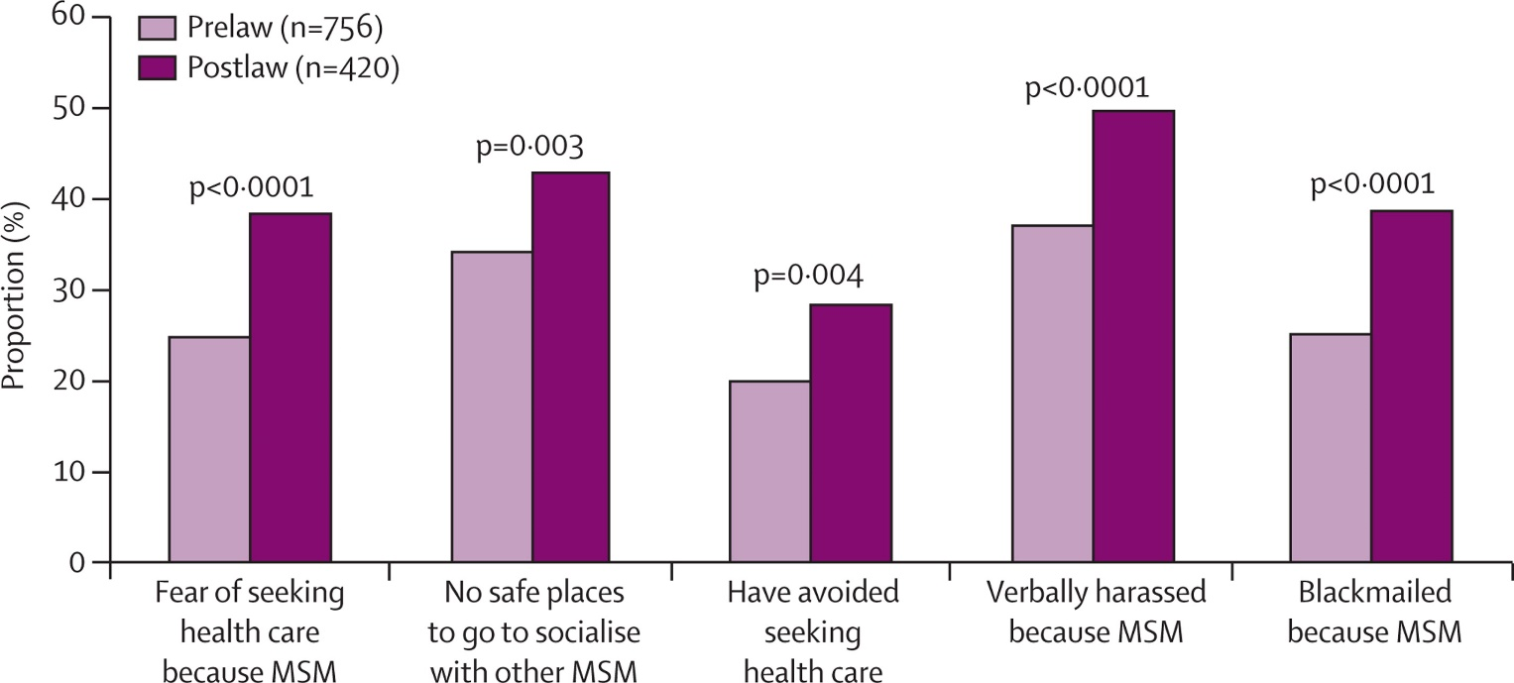
Same-sex marriage prohibition law discourages health seeking behavior in Nigeria
Schwartz, 2015
Notes:
Laws can also effect how people behave. This is a figure looking at the effect of a same sex marriage prohibition law in Nigeria, surveying MSM before and after passage of the law. You can see that compared to the prelaw period in light purple, during the post law period in dark purple, MSM were more fearful of seeking healthcare, and felt more persecuted. We as a medical community should be lobbying to overturn laws that criminalize sexual behavior that affects people willingness to known their HIV status and link to care.

Slide 10
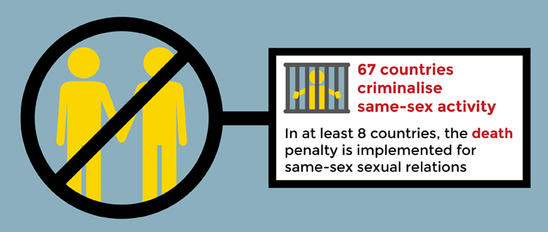
The Economist, 2019
Avert.org; UNAIDS 2019
Notes:
We have seen some progress on this front, including this recent article from the Economist highlighting that Botswana recently legalized gay sex. But, according to UNAIDS 2019 data, 67 countries criminalize same-sex activity mainly in Africa, the Middle East, and Russia.

Slide 11
Risk of mortality increases with number of self-perceived barriers to care
Barriers: e.g. Service delivery, financial
Dead at 1 year
N = 250
(13%)
Cox proportional hazards model controlling for gender, age, CD4 count, education, TB status, distance to clinic
Bassett, 2016; Bassett, in press
Notes:
I want to end the barriers section with showing how these barriers to care have effects on outcomes for patients. This was a study we did in South Africa looking at self-reported barriers to care at the time of HIV testing in categories like service delivery or financial barriers.
We found that nearly ¼ of people reported more than 3 barriers. By one year, 13% of participants had died. Even when controlling for known risk factors for death like CD4 count and TB, people reporting >3 barriers were nearly twice as likely to die by 12 months compared to those with no barriers; this relationship remained true over 5 years of follow up. So, people can tell us that they are experiencing barriers to health care which can predict poor outcomes and which need to be intervention targets.

Slide 12
Novel testing approaches
Notes:
Turning to interventions, I am now going to transition from barriers to testing and linkage, to talking about HIV testing innovations that attempt to overcome some of these barriers and appeal to populations who are less likely to know their HIV status.

Slide 13
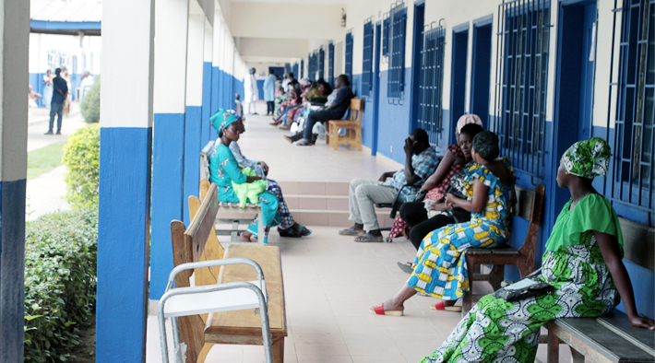
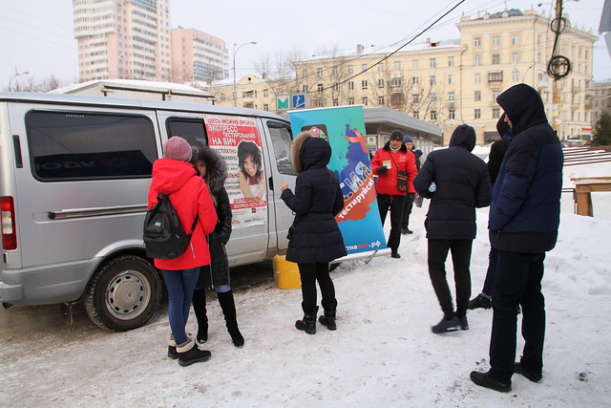
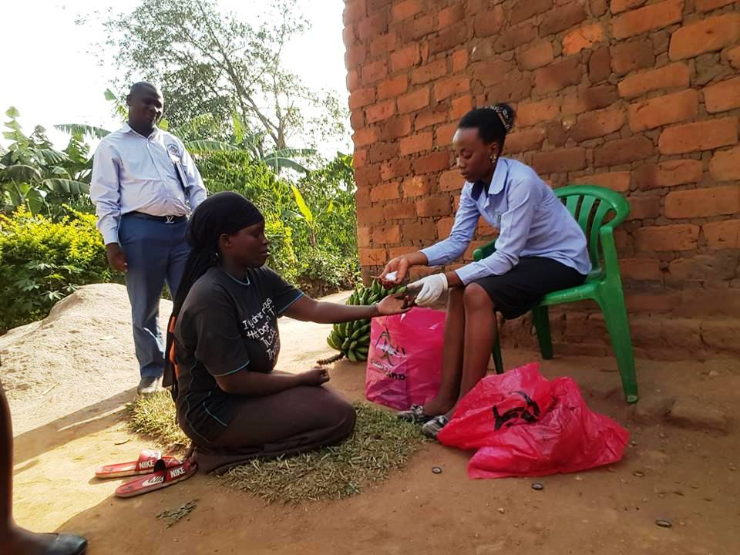
Community-based testing reaches some groups better than facility-based testing
Facility testing
Community testing
Home
HIV self-testing
Mobile
Campaigns
More likely to reach
Men
Young adults
First-time testers
UNITAID
WHO; Sharma, 2015
AIDS Healthcare Foundation
Uganda Empowerment Mission - UGEM
Notes:
Testing people for HIV at health facilities has been a critical part of efforts to increase HIV knowledge and awareness. But what about people who don’t come to facilities? We know that community based testing reaches some groups better than testing in facilities. Community testing includes testing outside of health facilities, like being tested at home by a counselor, self testing, mobile testing at community venues, testing at health campaigns. In a meta-analysis, men, young adults, and first time testers were more likely to be reached by community-based HIV testing than facility testing. Community-based testing overcomes some of the structural barriers of deciding to attend a clinic, transport, distance, and also may overcome stigma by normalizing testing. Lets look at some of these community testing methods in more detail.

Slide 14
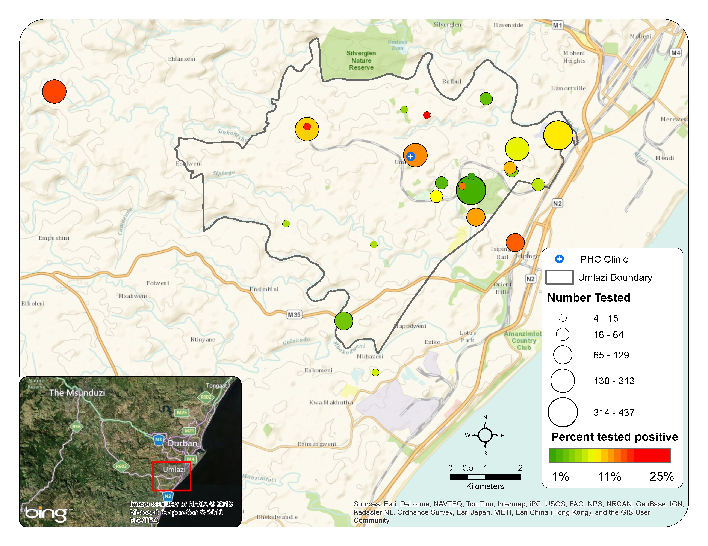
Mobile testing appeals to people who might not visit healthcare facilities
Mobile testers vs Clinic testers in South Africa:
-Younger
-More likely male
-Higher CD4 counts
-Further from home
Highest yield mobile sites:
-Commercial zones
-Transport hubs
Bassett, 2015
Notes:
This is a study that we did about mobile HIV testing in Durban South Africa in Umlazi township (outlined in gray on this map), comparing mobile testers, tested at community venues like markets and taxi stands to clinic testers.
We found that mobile testers were younger, more likely to be male, to have higher CD4 counts and tested further from home than those tested at clinic. Mobile testing can help identify where in the community we should be looking for these harder to reach populations. You can see on the map the circles represent testing locations with a range of HIV prevalences. We found that commercial zones and transport hubs had the highest yield for finding new cases. Mobile testing may overcome some structural barriers and stigma related to clinic visits. We’ll come back to mobile testing later when we talk about linkage strategies.

Slide 15
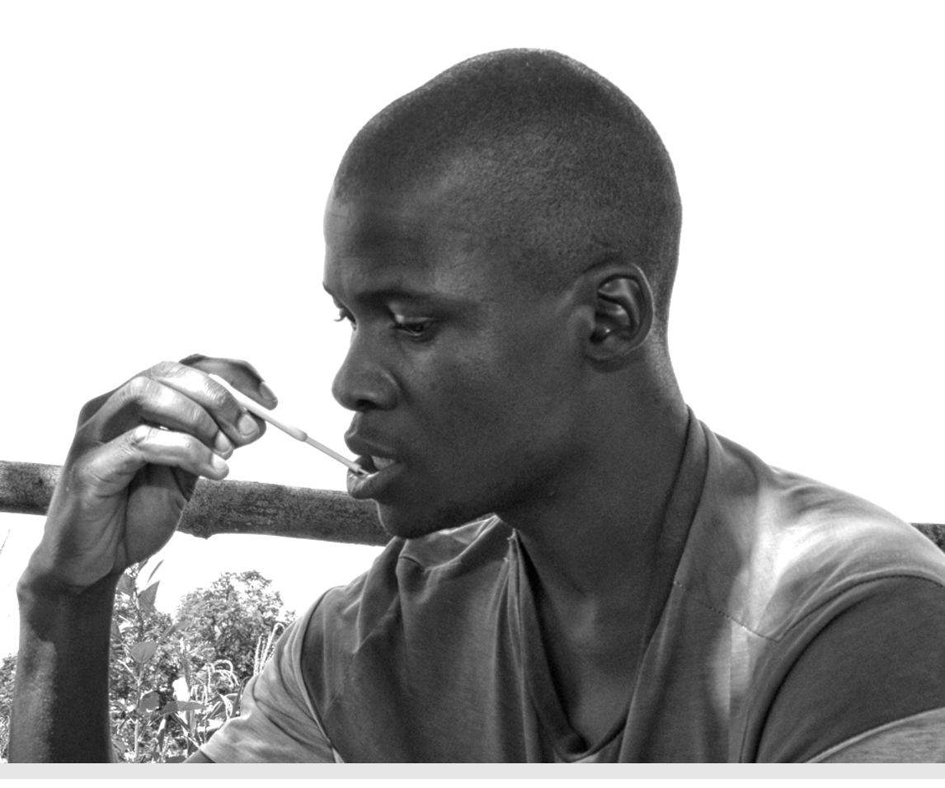
HIV self-testing also appeals to men, adolescents, 1st time testers
STAR - Malawi, Zambia, Zimbabwe
>600,000 HIVST distributed
48% to men
43% 16-24 year olds
20% first-time testers
HIV prevalence 1.9% vs 10.2% in facilities
UNITAID
Hatzold, 2019
Notes:
Another area of great interest is HIV self testing. This is a way of empowering people by allowing them to perform their own HIV test. The STAR initiative in Malawi, Zambia, Zimbabwe really spurred WHO to recommend HIVST in its 2016 guidance. STAR distributed over 600,000 oraquick HIVST kits, mainly through community venues.
They were able to reach men, people ages 16-24, and first-time testers better than we traditionally do in facilities. The HIV prevalence was lower among self-testers than those tested in facilities, but still substanial. This method may appeal to lower risk individuals. Could be useful for national testing campaign, catch up campaigns for areas with low testing coverage, or for people that may need frequent testing but are not willing to visit facilities.

Slide 16
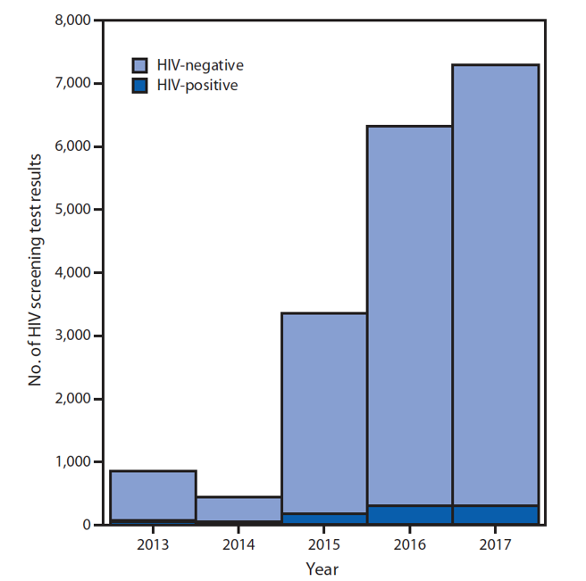
Social media to increase HIV testing among MSM in China
Campaign start
© Imagine China/REX/Shutterstock
Wang, 2019
Notes:
One way of reaching people is through their social network. This is a study of Blued – the largest gay dating and social networking app in the world with 40 million users, mainly in China. Blued launched an HIV testing campaign that included a one time mass message push notification, banner ads, and an embedded HIV testing appointment platform. After campaign launched in March 2015, shown by the purple line, HIV testing volume increased dramatically at the 6 Blued drop in centers in Beijing– with an HIV prevalence of nearly 5%.
So this is a way of finding a more “hidden” populatios by using a social media app that they have already embraced. This idea has been extending by others to incorporating key populations for distributing HIV self test kits to their own social network as a way of overcoming stigma and medical mistrust.

Slide 17
Assisted Partner Notification (APN) appears acceptable and high yield
In a systematic review, compared to passive referral, APN:
1.5X increase uptake of HIV testing
1.5X increase in identification of HIV-infected partners
3.7X increase linkage to care
HIV +
HIV –
HIV unknown
WHO, 2016; Dalal, 2017
Notes:
The final testing method that I want to touch on is assisted partner notification. Despite some initial concerns, this does appear acceptable. In this model people newly diagnosed with HIV like the yellow man in the middle of the circle, identify their contacts, be they sexual contacts, injection partners, or biologic children, and then the person is assisted in offering HIV testing to those contacts. In a systematic review done by the WHO, they found that compared to passive referral, with assisted partner notification there was a 1.5 times increase in the uptake of HIV testing, a 1.5 times increase in partners found to be HIV-infected, and also a 3.7 times increase in linkage to care for partners.
Assisted partner notification may be particularly helpful in countries with low HIV testing coverage where partners are less likely to undergo facility-based or other community testing.
While few instances of violence or harm were seen in this review, many studies exclude women with a recent history of intimate partner violence so social harms will still need to be monitored as this practice becomes more widely adopted.

Slide 18
Novel linkage solutions
Notes:
Now I am going to turn to strategies to improve linkage to HIV care, that attempt to overcome barriers to linkage and to appeal to harder to reach populations.

Slide 19
Linkage to care worse after community-based testing
Sharma, 2015
COMMUNITY
FACILITY
Notes:
I think one of the tensions here is that while community based HIV testing can be very appealing to people, it can also create an extra burden to actually be able to link people to care that may be based in the facility. In this figure from a meta analysis examining home and campaign-based HIV testing, only 26% of those newly diagnosed with HIV in home and community campaigns visited an ART clinic compared to 61% with facility based testing. The exception to that, is in the middle circle, which was home and campaign testing combined with facilitated linkage interventions which had a high rate of linkage.
So, while community methods for testing are appealing and may reach people that are otherwise difficult to reach, facilitated linkage strategies are needed to ensure that this testing leads to linkage care and ART initiation.

Slide 20
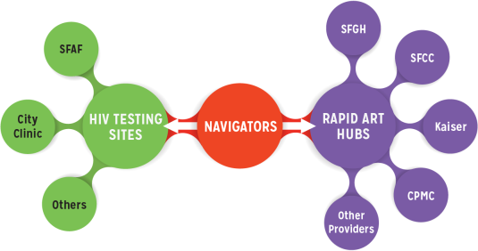
San Francisco Getting to Zero Initiative shortens time to VL suppression
San Francisco RAPID initiative
Median days | 2013 | 2014 | 2015 | 2016 | 2017
Diagnosis to first visit | 8 | 7 | 7 | 5 | 4
1st visit to ART start | 27 | 17 | 7 | 1 | 0
Bacon, CROI, 2018; Coffey, 2019; http://www.gettingtozerosf.org/rapid-committee/
Notes:
So what are some linkage strategies? In San Francisco they have taken a real systems-wide approach in their Getting to Zero Initiative. This is a Rapid ART program where they have created HIV testing “hubs” with community partners around the city where people newly diagnosed or out of care get expedited ART initiation and linkage to medical homes. Using Linkage navigators and standardized operating procedures throughout the city they were able to shorten the number of days from diagnosis to first visit from 8 to 4 days and from 1st visit to ART start from 27 to 0 days, between 2013 and 2017. This has resulted in a decline in new HIV diagnoses in San Francisco over the same period. This strategy may overcome structural and financial barriers as well as healthcare related stigma. We have seen good results with same day testing and ART initiation in clinic-based settings in studies in Haiti and South Africa as well.

Slide 21
Same day ART initiation at home is a promising strategy in rural Lesotho
Primary outcomes | Same-day ART N=137 | Usual care N=137 | P value
Linkage to care at 90d after enrollment | 69% | 43% | <0.001
Labhardt, 2018
Christian Heuss / Swiss TPH
Notes:
What about initiating ART in an expedited fashion at home? The CASCADE trial was the first trial to assess same day ART initiation outside of a health facility. In this study, people testing at home in rural Lesotho were randomized to either same day ART initiation at home by a trained team of nurse and lay counselors or usual care, which involved referral to health care facilities. When they looked at their primary outcome, same day ART initiators were more likely to have linked to care at 90 days, 69% in same-day group vs 43%, suggesting that starting ART at home and helping people make the transition to ongoing ART care in facilities is promising.

Slide 22
FSW in Tanzania do well with ART at location of their choice
Intervention – ART delivery at convenient community location
Comparison – facility-based ART
 | Intervention N=256 | Comparison N=253 | p
Linkage to care | 100% | 73% | <0.001
Stopped ART for >30d | 1% | 6% | 0.008
High internalized HIV-related stigma | 27% | 40% | 0.001
Tun, 2019
Notes:
Initiating ART outside of clinic has applications for key populations as well. This is a study in FSW who we know have high barriers to care in facilities, in which they went beyond not only initiating ART outside of the healthcare facility, but providing ongoing ART care for FSW in the community.
This was a study in Tanzania where community based teams offered mobile and home HIV testing to FSW – in the intervention district participants were also offered ART on an ongoing basis at a convenient community location of *their choice*, compared to the comparison district where people were referred to healthcare facilities. When they looked at linkage to care, ART interruptions and rates of internalized stigma, all of these were significantly better in people in the intervention district than the comparison district, suggesting that community-based ART initiation and ongoing ART dispensing for key populations may be a strategy for overcoming stigma and giving key populations more autonomy.

Slide 23
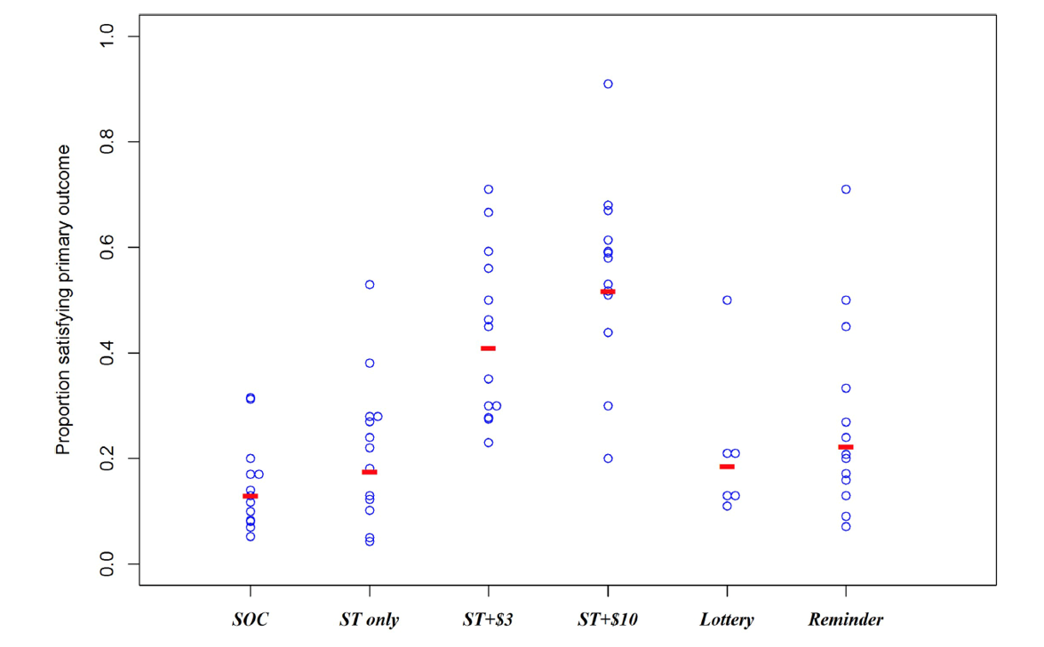
Incentives improve linkage to care for male partners of ANC clients following HIVST in Malawi
Proportion male partners tested and linked
to treatment or prevention
Standard of care | Self test | Self test + $3 | Self test +$10 | Self test + Lottery | Self test + Reminder
Choko, 2018
Notes:
What about linking after self testing? There is a lot of concern about people testing at home and whether they will still link to facilities. This is a study of linkage after self-testing for male partners of women in ANC in Malawi using incentives. Women were enrolled in antenatal clinic and randomized to standard of care (including letter inviting partners to test) or one of 5 intervention arms all with two HIVST kits for partners: either ST kits alone, ST kits plus varying financial incentives, or self test kits with a phone call reminder. The primary outcome was proportion of male partners with evidence of testing and linkage to care or prevention within 28 days.
Overall, only 28.8% of male partners had tested and were linked to treatment or prevention services. However, Rates of reaching the linkage outcome after self-testing with 3 and 10 dollar incentives and self-testing with a reminder were statistically significantly increased c/t standard of care, with self-test plus $10 group having about 52% linkage.
This study suggests that for men, incentives may be useful for helping them stay in the care cascade. Incentives may help provide tangible benefits to testing and linkage and offset some of the real costs associated with missing work, but I would say overall in the literature that evidence for financial incentives has been mixed and we need to know more about how best to structure them for maximum benefit.

Slide 24
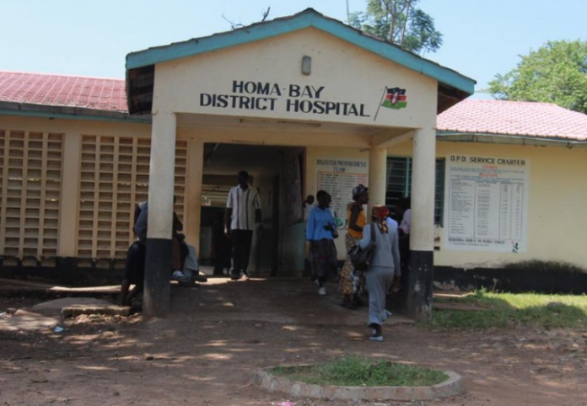
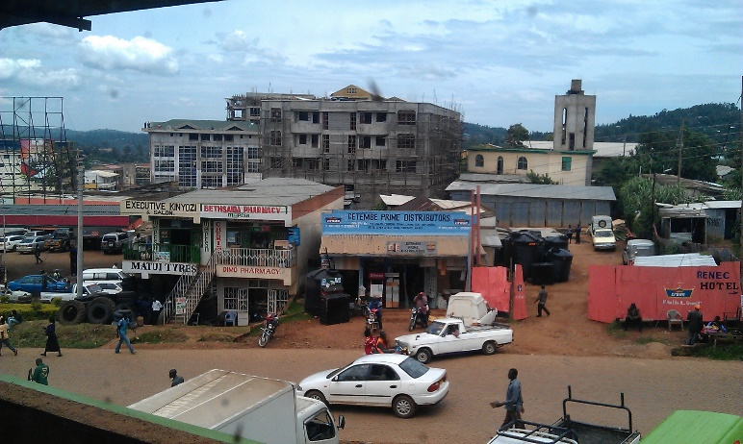
Youth-designed program improves linkage and retention for adolescents in Kenya
http://tahmo.org
http://www.kbc.co.ke
https://informationcradle.com
Boarding School
Health Facilities
Community Services
 | Pre N=393 | Post N=559
Linked to care | 57% | 97%
Initiated ART | 72% | 79%
Retained on ART 3mo | 56% | 90%
Ruria, 2017
Notes:
While there are many studies related to HIV TESTING strategies for adolescents, there are very few studies about linkage to care strategies for adolescents.
This was a notable exception of a pilot program in Kenya in which they tried to address this issue at multiple levels, with components at boarding schools, health facilities and in the community through peer services. What is remarkable about this was that youth and adolescents were involved in designing and monitoring the intervention, which includes, for example, VIP adolescent-friendly express services in clinics so that youth would not have to wait.
In a Pre and post intervention design, linkage to care, ART initiation and the proportion of youth retained in care at 3 months increased significantly. This is promising, but linkage to care for adolescents is an area that needs a lot more work.

Slide 25
‘Treat All’ Policy shift for linkage
2015 WHO recommends ‘treat all’,
no CD4 threshold, no ‘pre-treatment phase’
Barriers: inconvenient clinic hours, overcrowded clinics, health provider attitudes, stigma and shame
New challenge: people who feel well
Notes:
I want to change to talking about a policy shift which is important for linkage to care as it relates to the WHO recommendation to Treat all people regardless of CD4 count thus condensing the pre-treatment phase of the care cascade. Some studies performed under treat all conditions had disappointing rates of linkage to care. Barriers to linkage to care in these trials have included inconvenient clinics hours, overcrowded clinics, health provider attitudes, stigma and shame. While this policy is the right one from a public health perspective, in some sense it creates a new challenge, people that are feeling well who may not see the value of getting into care quickly.

Slide 26
SEARCH ‘Treat All’ Trial promising linkage results in Kenya and Uganda
SEARCH intervention components (with universal ART):
Integrated, multi-disease community campaigns + home-based testing
Patient-centered linkage
Havlir, 2019
Notes:
I’ll highlight just one study which tried to overcome barriers to Treat All, that was the SEARCH trial, a community cluster randomized trial in Kenya and Uganda. They combined really two different ideas with universal ART to address some of these structural, behavioral and health systems barriers. One idea was integrated health screenings, including HTN, diabetes, cervical Ca, PLUS HIV screening in mobile community health campaigns and in home-based testing for those not seen at the campaigns. This integration may help destigmatize HIV testing and resulted in 90% of residents undergoing HIV testing in the trial. The second aspect of this intervention was patient-centered linkage components. This included being immediately introduced to clinic staff, flexible clinic hours, appointments with appointment reminders, transport reimbursement, as well as providing a hotline where people could contact providers for questions or support – these are all services generally not available in RLS.
This trial had high rates of linkage to care, with 83% of people in the intervention group not on ART at baseline starting treatment by 3 years, as shown in blue, compared to 50% in the control group who were treated under national guidelines and usual care conditions. Integration and patient-centered services may be important for the Treat All policy to be effective.

Slide 27
Integration of SUD and HIV services may improve outcomes
Linking infectious and narcology care (LINC) at hospital in Russia
Peer-led case management intervention
 | Intervention N=174 | Control N=175 | P value
Linkage to care | 51% | 31% | <0.001
CD4 count at 12 month, median (/μL) | 343 | 354 | 0.25
Appropriate HIV care (ART or 2nd CD4) | 33% | 23% | 0.04
Samet, 2019
Notes:
Integration of other health services that may be important to the person, with their HIV services, also shows promise in other settings. This is an example of integration of services for substance use disorder and HIV. This randomized trial used a strength-based case management intervention for people hospitalized in Russia for substance use led by peers, PLHIV with a history of injection drug use. This trials shows some promise, in that those in the intervention arm were more likely to link to care compared to in the control arm, but there was no difference in CD4 count at 12 mo and overall entry into care was low. I think this speak to the siloes of addiction care and HIV care in this setting.

Slide 28
Integrating HIV testing into family planning increases testing, BUT…
2019 systematic review: No studies measured
linkage to HIV care and treatment following integration of HIV testing into family planning services
Narasimhan, 2019
Notes:
Many of the interventions that I have described focus on men. What about women at high-risk? I really wanted to have a slide about linkage to care following integration of HIV services with family planning services, and while there are many studies looking at HIV TESTING among family planning clients and this seems a promising approach, (press) a systematic review published this year showed there were actually NO studies that measured linkage to HIV care and treatment following integration of HIV testing into family planning services. In certain settings, like sub Saharan Africa, young women are at extremely high risk for unintended pregnancies, HIV, and STIs. Therefore, studies that look at the integration of HIV testing AND linkage services into family planning are critical as we move forward toward the testing and linkage goals.

Slide 29
What about those entering through the “side door”?
“Front door”
TESTING
ART INITIATION
VIRAL SUPPRESSION
“Side door”
Drop-out
re-initiating
Adapted from Hallett, 2013
Notes:
Most of the people that we have been talking about thus far are people entering care through the front door - people undergoing HIV testing and initiating treatment. What about people who have been in care and have then dropped out care and are now re-initiating, or entering through the side door?

Slide 30
Increasingly PLHIV with CD4 <50 are ART-experienced, Western Cape, S. Africa
Proportion of patients with CD4 count <50 cells/µL by previous ART exposure, eligibility, and previous CD4 count testing, by year
Osler, 2018
Notes:
These people are of increasing import in mature ART programs. For example, these are data from the Western Cape province of South Africa which has a well-developed public sector HIV program. This is an annual cross sectional snapshot of the proportion of people with a CD4 count of <50 based on their past history of ART exposure. You can see in the red bars that people attending HIV care for the first time initially constituted the largest proportion of people with CD4 < 50 and this dropped over time from 60-21%. By contrast, the proportion of people in purple, people who were previously on ART and are now coming back with a CD4 < 50, has increased dramatically over that time from 14% to 57%.
This high-priority group will continue to grow as Treat All expands, more PLHIV initiate ART, disengage from care, and then need to be re-engaged. A recent systematic review found NO studies specifically focused on PLHIV who had fallen out of HIV care or were previously on ART.

Slide 31
Welcome Service in Khayelitsha, South Africa
Keane, IAS consultation, 2019
Notes:
Here I highlight a pilot program from Medicine san Fronty-AIR in Khayelitsha that is trying to encourage re-engagement through there welcome service. At one of their clinics, they are actively tracing people through clinic files who have dropped out care, and also trying to attract people through WhatsApp and Facebook to invite disengaged people back into care. They are offering psychosocial support and peer navigation with an emphasis on normalizing disengagement and empathizing, so people feel welcome to come back into care. This is still in the pilot phase, but I think a very promising approach.

Slide 32
Conclusions and what’s next

Slide 33
Conclusions
Actively pursue hard to reach populations to get to 90-90-90
Test people “where they are”
Home, mobile, HIV self testing, social media
Provide choices for linkage to care
Facilities, home, school, community sites
Integrated with other health services
Welcome back those previously in care
Notes:
We need to actively pursue hard to reach populations - include males, adolescents, key populations and those in rural areas - to get to 909090
Testing people where they are, be that at home, through mobile testing, HIV self-testing and through social media, seems particularly promising
We should provide choices for linkage to care and ART delivery that are patient-centered and flexible – these can be at facilities, but also at home, school, or community sites. HIV services should be integrated with other key health services (like NCD’s, substance use, family planning)
We should make efforts to welcome back those previously in care.

Slide 34
Closing thought
No one should be diagnosed late or die of HIV in the setting of rapid HIV testing and well-tolerated, widely available ART.
We need to redouble our efforts to close the gaps in HIV care.
Notes:
So my closing thought that is that…. No one should be diagnosed late or die of HIV in the setting of rapid HIV testing and well-tolerated, widely available ART. We need to redouble our efforts to close the gaps in HIV care.

Slide 35
Thank you!
United States Collaborators
Kenneth Freedberg
Rochelle Walensky
Robert Parker
Elena Losina
Laura Bogart
Bridget Bunda
IAS
Carlos del Rio
Anna Grimsrud
Funders
NIH R01 MH108427
NIH R01 MH114997
NIH K24 AI131046
Weissman Family MGH Research Scholar
Harvard Center for AIDS Research
South Africa Collaborators
Linda-Gail Bekker
Andrew Boulle
Janet Giddy
Sabina Govere
Hilary Thulare
Sandile Tshabalala
Notes:
I’d like to thank my colleagues in the US and South Africa, the IAS for inviting me, and the funders who support my research. [Fue un honor dar esta conference en America Latina. Mi madre Peruana tambien esta emocionada]. Thank you.

